Slide 1




Simulation-based Optimization of Reusable Container Cycles (SIBORC)
Project duration: 11/2024 – 05/2027 (32 Monate)
Consortium lead: Fraunhofer Austria, https://www.fraunhofer.at/de/forschung/digitalisierung_und_ki.html
Project lead: Assoc.-Prof. DI Dr. Erich Teppan, erich.teppan@fraunhofer.at
Consortium:
  afreshed GmbH
  BOOXit OG
  CompUnity GmbH
  FHW Fachhochschul-Studiengänge Betriebs- und Forschungseinrichtungen der Wiener Wirtschaft GmbH
  Fraunhofer Austria GmbH

Slide 2
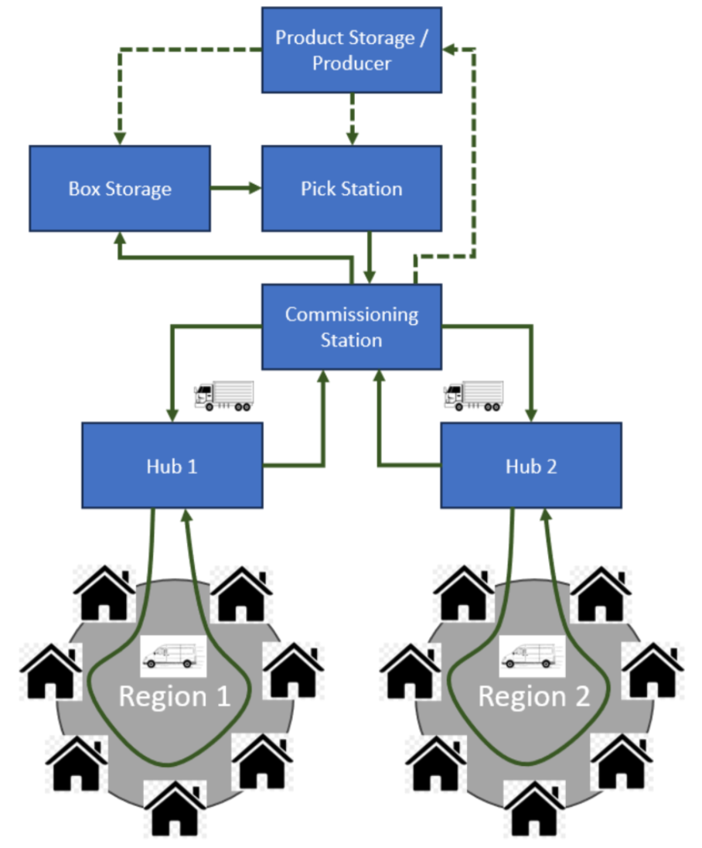
Project SIBORC: Simulation-based Optimization of Reusable Container Cycles
Milk-run processes
  Parcel delivery
  Pharma logistics
  Etc.
Empty containers return to senders
  Additional optimization problems
Simulations / digital twins
Optimization through iterativ adaption of parameters
Also optimization criterion is adapted iteratively

Slide 3

Project SIBORC: Simulation-based Optimization of Reusable Container Cycles
Inputs
Simulation engine
(digital twin model)
Output
(solution candidate)
Optimization criteria
Critique

