Slide 1
AAL projects Trainutri & WayFiS: Participation experience after one year
Dr Michel Deriaz
Michel.Deriaz@unige.ch

Slide 2
TRAINing and NUTRItion senior social platform
Targets
Raise consciousness about self wellness
Help people (50 to 65 years) to develop healthy habits
Enable the exchange of knowledge related to physical and nutritional healthy habits

Slide 3
TRAINing and NUTRItion senior social platform
Status
Started April 2010 – 2 years project
Specifications , scenarios and architecture
First tests for fall 2011

Slide 4
Tentative logo
Targets
Improving the capability of seniors to plan, manage and execute travel and transportation projects taking into account their specific limitations and healthy habits
Making the elderly feel healthy-well and safe
Not technology centered

Slide 5
Status:
Started March 2011 – 30 months project

Slide 6
Relation between and
Creating healthy habits early elderly: 50-65
Wellness habits Eating, exercising
Encouragement and reward
Social network
Personalized services
Maintaining active life advanced elderly: 75+
Urban & sub-urban travel bus, tram, walking …
Points of interest parks, pharmacy, toilets, benches to sit ..
Personal capabilities, Mobility limitations
Learning service
User Centric Services
Technology : Mobile computing and communications

Slide 7
Experience in Participating to AAL projects in Switzerland
Finding the idea
Setting up the consortium
Convincing the Swiss commercial partner!!
Running the project

Slide 8
From Idea to Project
Unige’s participation was motivated by
Past research results in e-health, mobile services, socio-economic aspects
Personal interest in the development of QoL services
Requirements
Innovative ideas federating multi-disciplinary research

Slide 9
Finding Partners
Differences between EU and Swiss funding schemas for private companies
EU : funding of companies from 50% to 75%
Swiss : funding of companies from 0% to 0% !!
The private Swiss company must work in the domain and ready to invest
Obligation to have a private company partner
Required but difficult to get : end user organisations

Slide 10
The future for Unige
Open for participation in Call 4 proposals bringing expertise in areas like
Mobile services, Health related and QoL issues
Project organisation and set up
Network of commercial partners
Patient monitoring & end users
Geolocalisation services

Slide 11
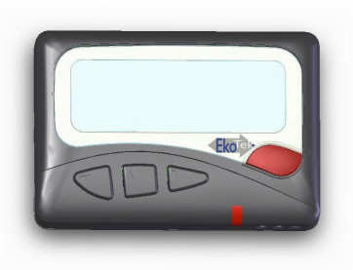
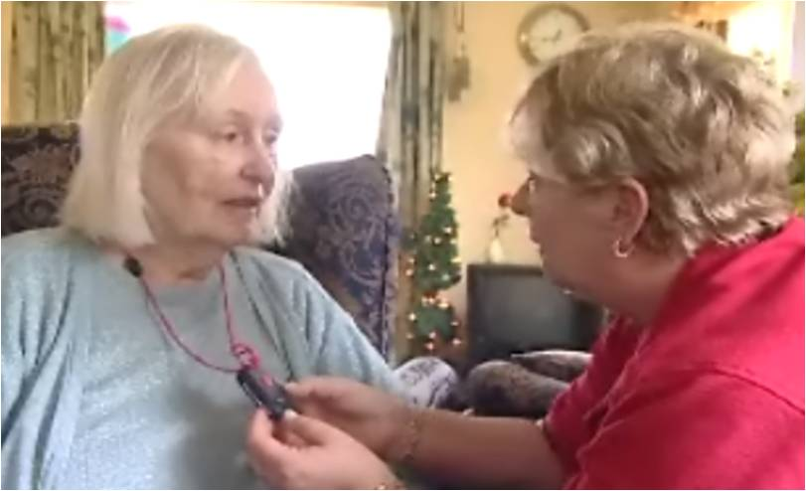
Vigisense and MyAmego
Required location
Mr Dali
WC’s – 120 min
Innovative, person-centred healthcare wireless monitoring
Monitoring of behaviour patterns
Advanced care for Alzheimer, psycho-geriatrics and rehabilitation
Automatic calls to nurses

Slide 12
Vigisense’s R&D roadmap
Care Home
Private Home
Alzheimer
Psycho-Geriatrics
Other Chronic Diseases

Slide 13
Vigisense’s contribution
Helps to find the real user’s needs
Helps to find who actually are the users
Tests the work in real cases
Contact Vigisense SA, info@vigisense.com
Serge Grisard, CEO
sgrisard@vigisense.com; mobile: +41 79 400.37.33
Vigisense France SAS, Lyon: Franck Bauer, fbauer@vigisense.com

Slide 14
arx iT
GIS company since 2002, in Geneva, Paris and Lyon
15 engineers
Mobile pole since 2009
Contributes with know-how and georelated codes or services
Contact: David Beni (CEO), dbe@arxit.com

